Slide 1
Big Data Genomics Education for Undergraduate Professors
Jeffrey Chuang
The Jackson Laboratory for Genomic Medicine
May 2018

Slide 2
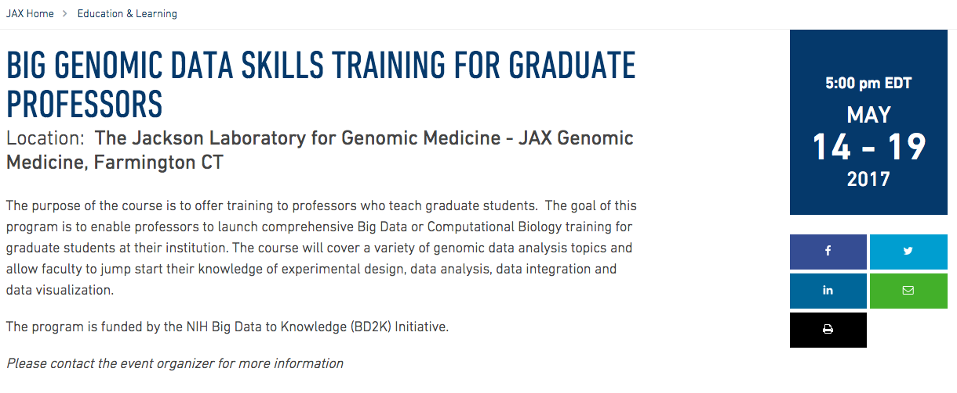
R25 for Genomics Training

Slide 3
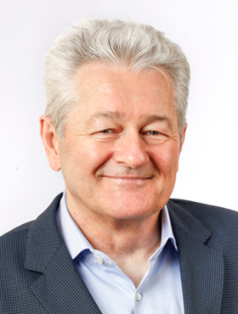
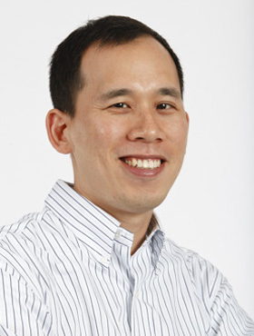
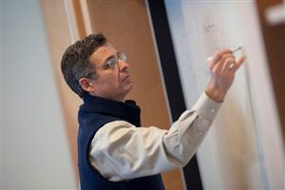
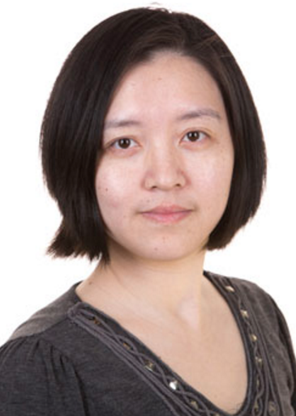
Introduction of course organizers and staff
Charlie Wray, PhD - JAX
Director of Courses and Conferences
Prof. Reinhard Laubenbacher – JAX;
U. Conn. Health: Director of the Department of Quantitative Medicine
Prof. Jeffrey Chuang – JAX; U. Conn Health Department of Genetics and Genome Sciences
Spencer Glantz - JAX
Postdoctoral Fellow
Sandeep Namburi, Cloud Systems Analyst, JAX IT
Aditya Kovuri, Programmer Analyst, JAX IT
Amanda Lazarus, Administrative Assistant
JAX Genomic Education
Ada Zhan, PhD – JAX
Postdoctoral Fellow

Slide 4
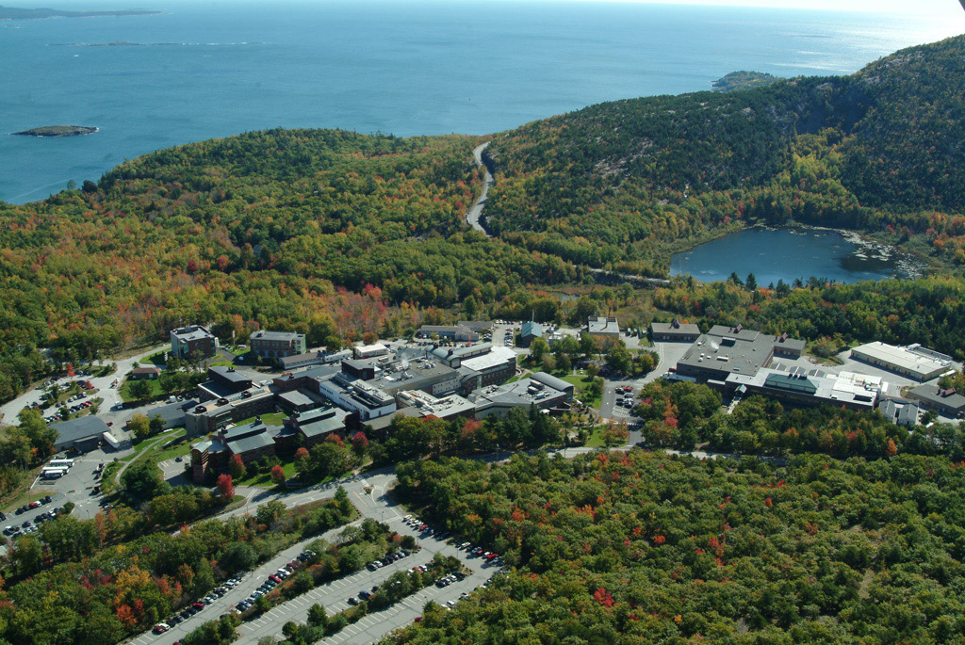
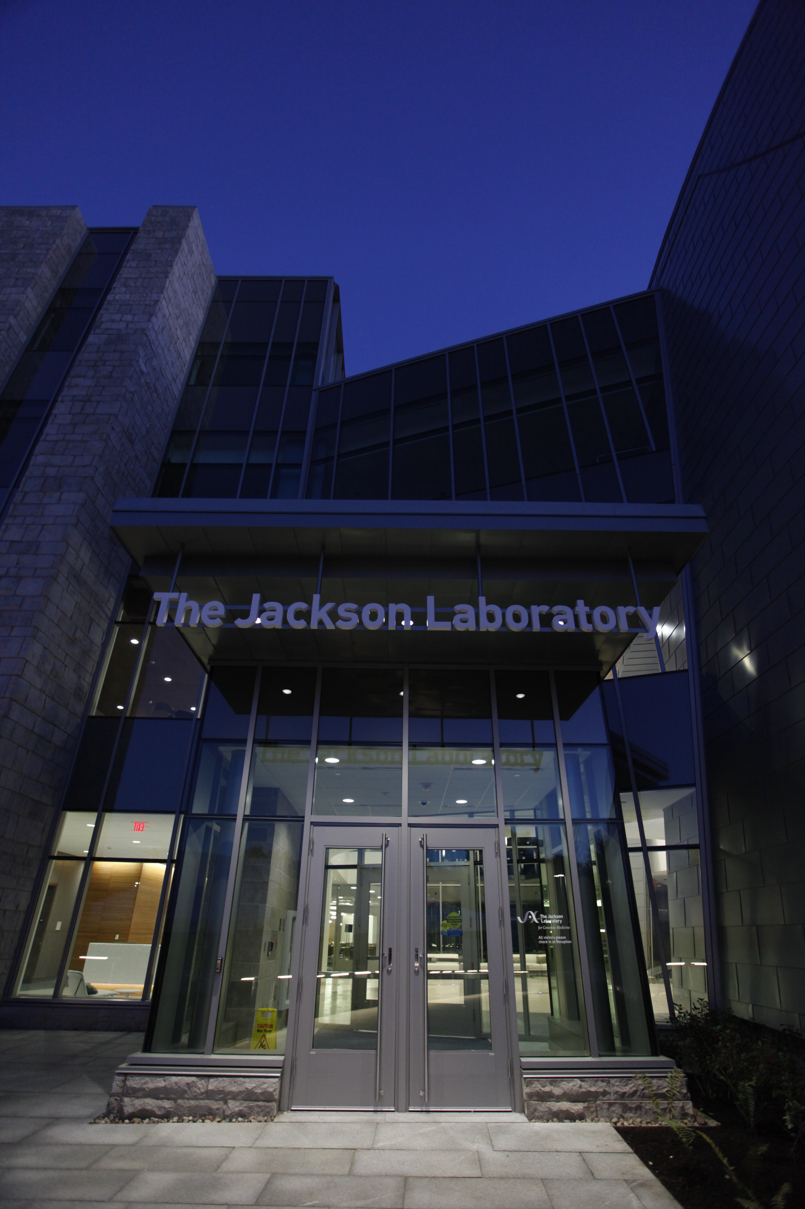
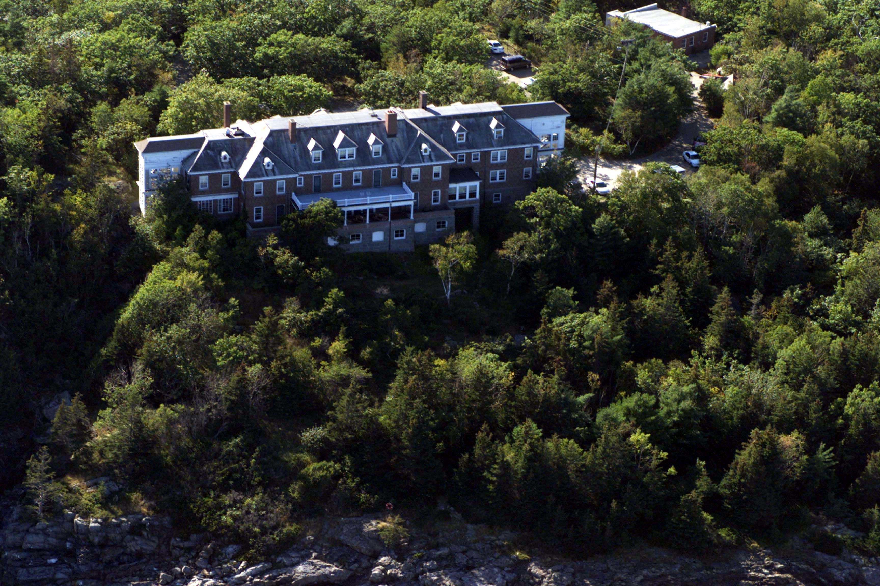
Overview of The Jackson Laboratory Education
Mission:
We discover precise genomic solutions for disease and empower the global biomedical community in our shared quest to improve human health.
Notes:
85 years of research and education in Bar Harbor Maine.
1 Faculty, 3 summer fellowship students have been awarded Nobel Prizes in Medicine or Physiology
26 Nobel prizes have depended on JAX mice as scientific resources
Genome was coined by JAX faculty: The World standard genome database: MGI program based in Bar harbor
Produce and supply over 7000 varieties of mice to the worldwide research community to the tune of 3M mice per year to 20,000 investigators or laboratories per year

Slide 5
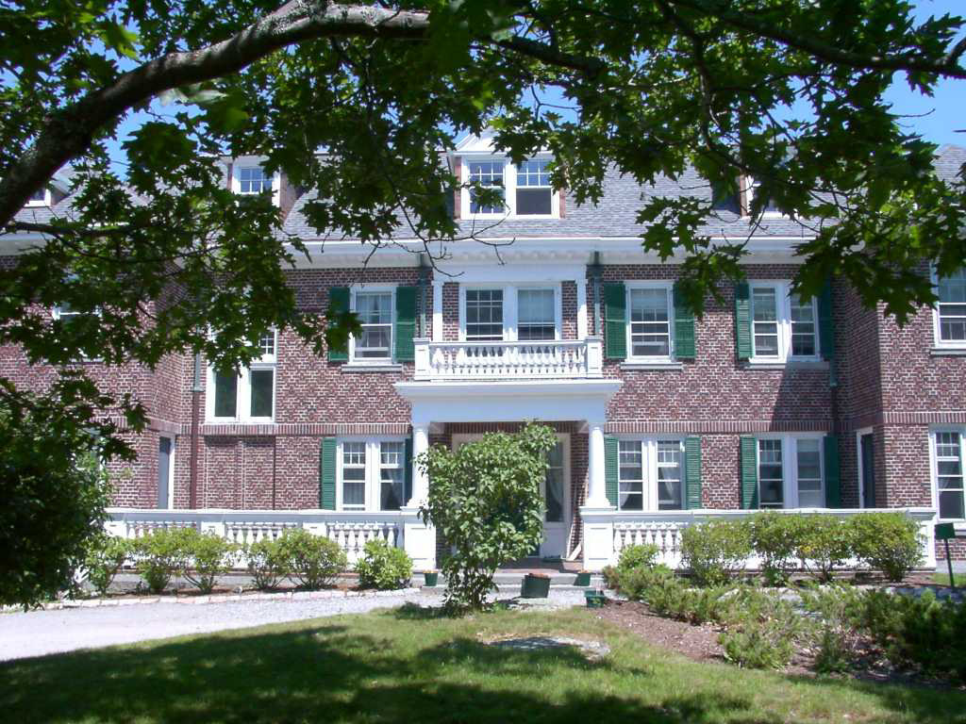

The JAX Education Ecosystem
Continuing Professional Education
Courses & Conferences
Postdoctoral Program
Predoctoral Program
STEM &Summer High School/ Undergraduate Program
JAX Mission
Notes:
2013 Education was carefully reorganized into 5 major interlinked programs
Today I will speak mainly about Courses and Conferences and touch on other programs
20-25 educational programs are given in Maine annually, and we will deliver 4-6 programs annually in CT and 4-5 across the United States and internationally each year

Slide 6
R25 Participant Survey

Slide 7
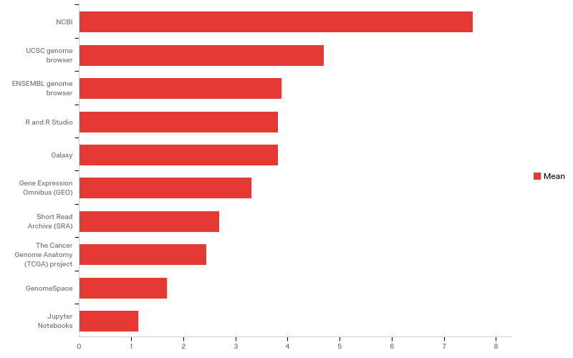
Q1 - From 1 (least) to 10 (highest), rate your knowledge of/familiarity with each of the following:

Slide 8
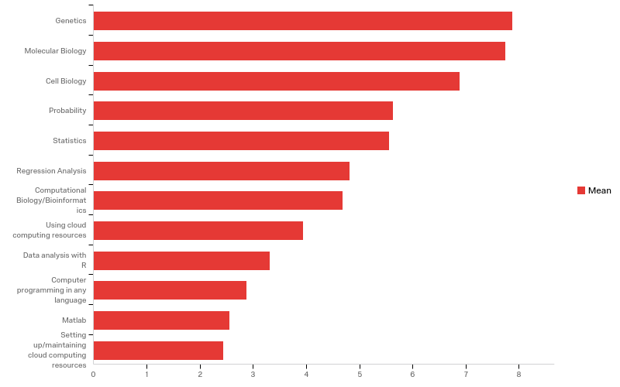
Q2 - From 1 (no knowledge) to 10 (expert), rate your expertise on each of the following:

Slide 9
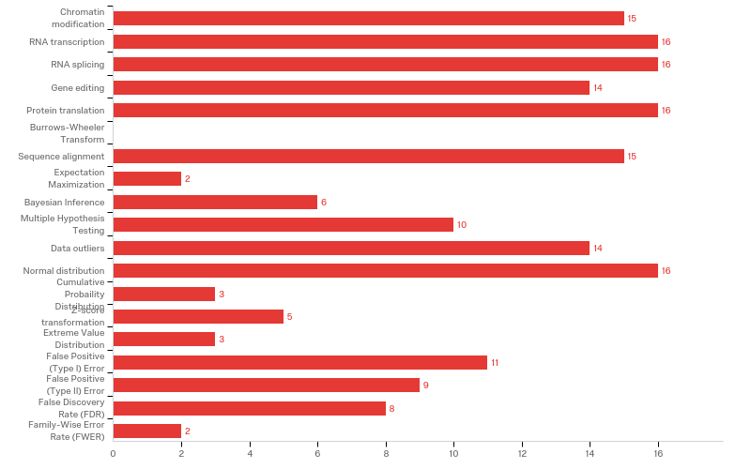
Q3 - Which of the following terms could you define without the use of Google or another search engine (select all that apply):

Slide 10
Q3 - Which of the following terms could you define without the use of Google or another search engine (select all that apply):
# | Answer | % | Count
1 | Chromatin modification | 8.29% | 15
2 | RNA transcription | 8.84% | 16
3 | RNA splicing | 8.84% | 16
4 | Gene editing | 7.73% | 14
5 | Protein translation | 8.84% | 16
6 | Burrows-Wheeler Transform | 0.00% | 0
7 | Sequence alignment | 8.29% | 15
8 | Expectation Maximization | 1.10% | 2
9 | Bayesian Inference | 3.31% | 6

Slide 11
Q3 - Which of the following terms could you define without the use of Google or another search engine (select all that apply):
# | Answer | % | Count
10 | Multiple Hypothesis Testing | 5.52% | 10
11 | Data outliers | 7.73% | 14
12 | Normal distribution | 8.84% | 16
13 | Cumulative Probaility Distribution | 1.66% | 3
14 | Z-score transformation | 2.76% | 5
15 | Extreme Value Distribution | 1.66% | 3
16 | False Positive (Type I) Error | 6.08% | 11
17 | False Positive (Type II) Error | 4.97% | 9

Slide 12
Q3 - Which of the following terms could you define without the use of Google or another search engine (select all that apply):
# | Answer | % | Count
18 | False Discovery Rate (FDR) | 4.42% | 8
19 | Family-Wise Error Rate (FWER) | 1.10% | 2
 | Total | 100% | 181

Slide 13
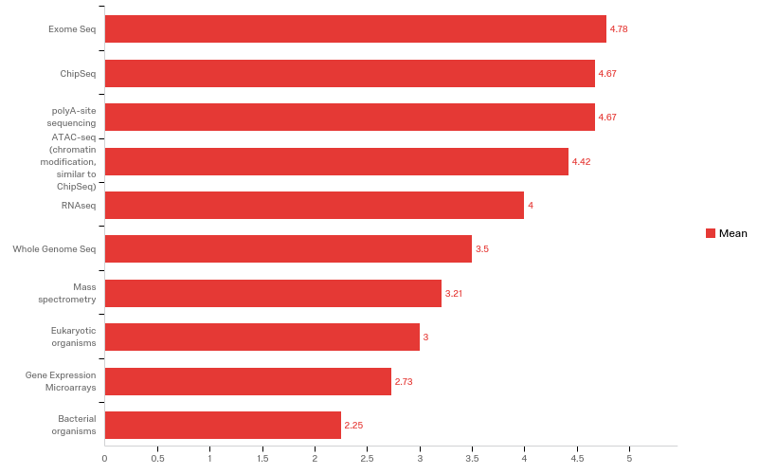
Q4 - From 1 (not interested) to 5 (very interested), rate your interest in learning to work with the following data types. Please select N/A if you are not familiar with the data type.

Slide 14
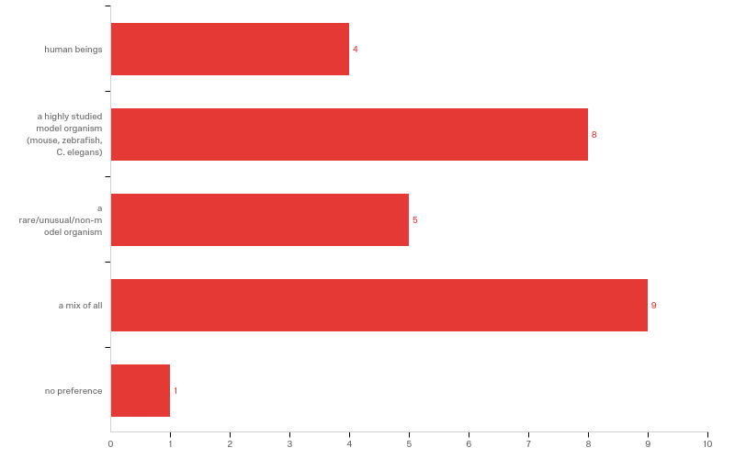
Q5 - Which are you more interested in data generated from:

Slide 15
Q5 - Which are you more interested in data generated from:
# | Answer | % | Count
1 | human beings | 14.81% | 4
2 | a highly studied model organism (mouse, zebrafish, C. elegans) | 29.63% | 8
3 | a rare/unusual/non-model organism | 18.52% | 5
4 | a mix of all | 33.33% | 9
5 | no preference | 3.70% | 1
 | Total | 100% | 27

Slide 16
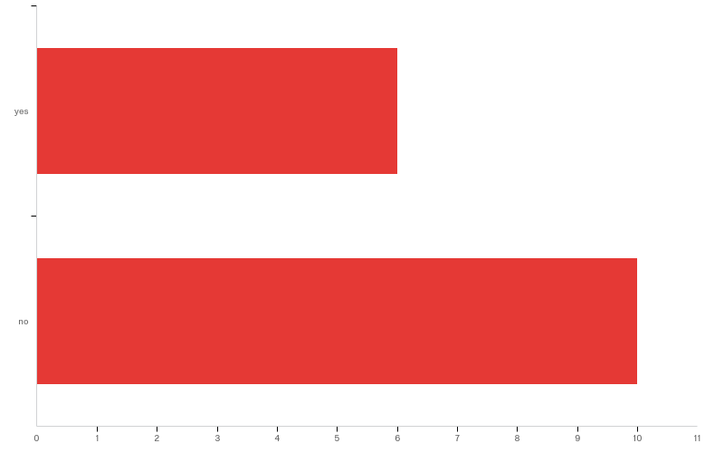
Q10 - Do you have genomic data you might bring to the course?

Slide 17
Q10 - Do you have genomic data you might bring to the course?
# | Answer | % | Count
1 | yes | 37.50% | 6
2 | no | 62.50% | 10
 | Total | 100% | 16

Slide 18
Q11 - Please describe data you may bring to the course:
Please describe data you may bring to the course:
I have soft-shell clam genomic data in Galaxy
RNA Seq data from mouse eye treated with NaOH +/- transcription inhibitor
I have several bacterial (Burkholderia) genomes I could bring.
I have proteomic data but not genomic data currently available
Drosophila melanogaster brain RNAseq data
Shotgun Metagenomics and 16S marker gene metagenomic data sets
I have 2 data sets comparing treated and untreated cancer lines and looking at transcript expression using Affymetrix GeneChip Human Transcriptome Arrays 2.0

Slide 19
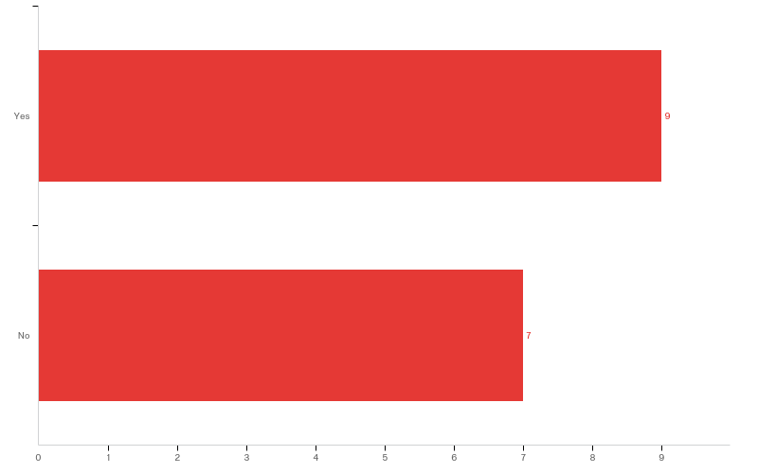
Q6 - Do you have access to a computing cluster that students will be able to login to and perform calculations?

Slide 20
Q6 - Do you have access to a computing cluster that students will be able to login to and perform calculations?
# | Answer | % | Count
1 | Yes | 56.25% | 9
2 | No | 43.75% | 7
 | Total | 100% | 16

Slide 21
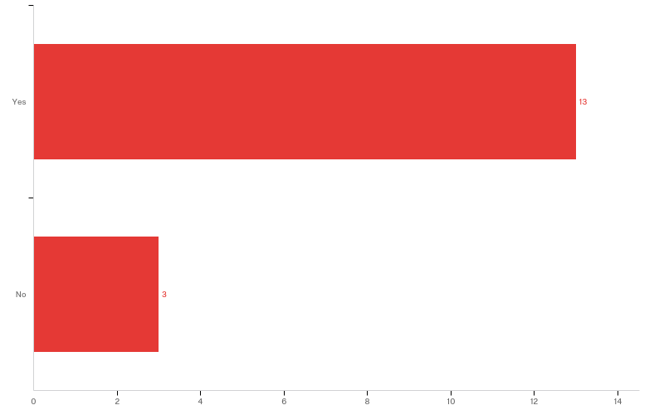
Q8 - Does your college or university have dedicated IT support that can assist you with activities such as software installation?

Slide 22
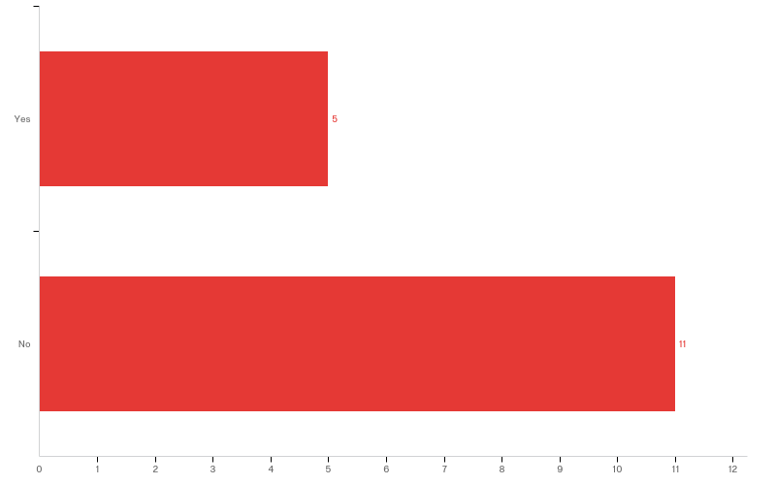
Q9 - Do you have access to teaching assistants to help you mentor students through computational lab activities?

Slide 23
Q9 - Do you have access to teaching assistants to help you mentor students through computational lab activities?
# | Answer | % | Count
1 | Yes | 31.25% | 5
2 | No | 68.75% | 11
 | Total | 100% | 16

Slide 24
Introduction of Participants

Slide 25
Outline of Schedule

Slide 26
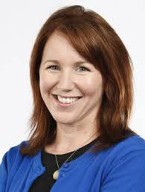
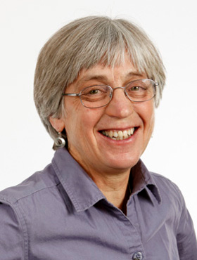
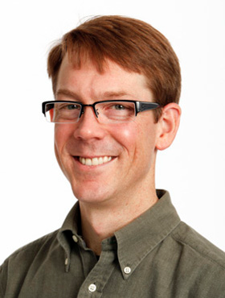


Speakers
Christine Beck Sheng Li Laura Reinholdt Judy Blake Greg Carter
JAX JAX JAX JAX JAX
Human Genetics RNA-seq Mouse genetic variation Reproducibility Data Integration
Neil Kindlon, JAX, UNIX scripting
Parveen Kumar, JAX, Pathways
Tim Reynolds, JAX, Gene Weaver
Jason Bubier, JAX, Gene Weaver
Michael Linderman Andrea Tilden
Middlebury College Colby College
Running an UG Course Running an UG Course

Slide 27
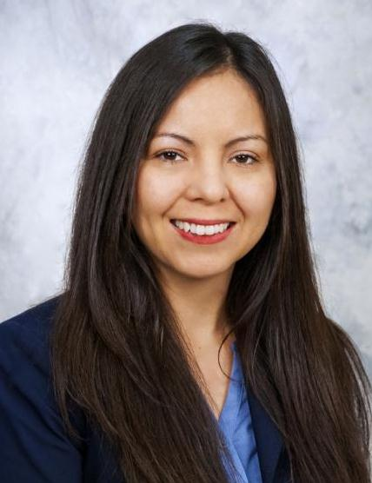
Speakers
James Taylor Paola Vera-Licona Shallee Page
Johns Hopkins UCONN-Health Franklin Pierce University
Galaxy Network Modeling Running an UG course

Slide 28
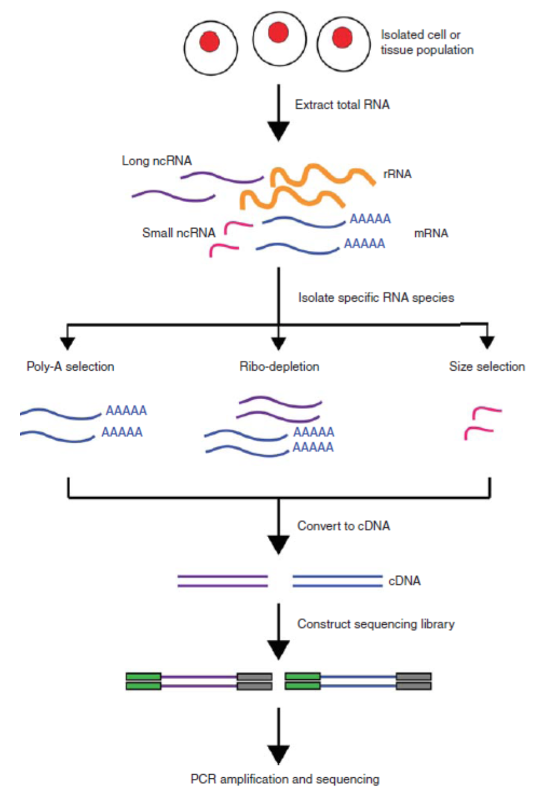
Outline Day 1
Monday
8:30am Welcome and Introduction
9:00am Introduction to Data Science with Biological Emphasis
Jeffrey Chuang, Ph.D., The Jackson Laboratory for Genomic Medicine
10:00am Intro to High-Throughput Sequencing Technology
Charlie Wray, Ph.D., The Jackson Laboratory
11:00am Hands on Work: Setting up computing infrastructure. R, Python, Slack and other common Tools,
12:00pm Lunch
1:00pm Introduction to UNIX
Neil Kindlon, The Jackson Laboratory for Genomic Medicine
2:30pm Introduction to Statistics
Jeffrey Chuang
3:30pm Break
4:00pm Curricular Discussion – Presentation and Discussion of UG courses in Genomics, Reinhard Laubenbacher, Ph.D., JAX-GM / UConn Health; Charlie Wray, Ph.D., The Jackson Laboratory 5:00pm RNA-seq
Sheng Li, Ph.D., The Jackson Laboratory for Genomic Medicine
6:00pm Dinner
7:00pm Evening Lecture
Christine Beck, Ph.D., The Jackson Laboratory for Genomic Medicine

Slide 29
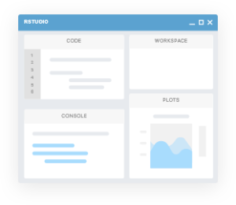
Outline Day 2
Tuesday
8:30am RNA-seq introduction
Ada Zhan, Ph.D., JAX-GM
9:00am RNA-seq module 1
Ada Zhan
10:00am Break
10:30am RNA-seq module 1, continued
12:00pm Lunch
1:00pm Module 1 debrief
1:30pm Gene Set Enrichment and Pathway Analysis
Parveen Kumar, Ph.D., JAX-GM
2:30pm Gene Weaver – Advanced / Derived RNA-seq analysis
Tim Reynolds and Jason Bubier, PhD,The Jackson Laboratory
4:00pm Break
4:30pm Mutation and Functional Analysis in R. Example lesson.
Jeffrey Chuang, Ph.D., The Jackson Laboratory for Genomic Medicine
5:30 End. Dinner on your own.

Slide 30
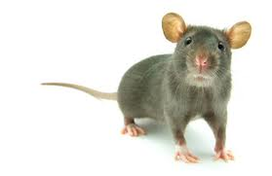
Outline Day 3
Wednesday
8:30am Debrief on Module #2 Variant Calling: Lessons learned, Q & A.
9:00am Exome Sequencing for Variant Discovery
Laura Reinholdt, Ph.D., The Jackson Laboratory
10:00m Module #3: Mouse Exome Variant Discovery.
Charles Wray, Ph.D. The Jackson Laboratory
12:00pm Lunch
1:00pm Introduction to the Microbiome
Spencer Glantz, Ph.D., JAX-GM
2:00pm Hands on Microbiome Work
Spencer Glantz
3:30pm Break
4:00pm Curricular Discussion #2
4:30pm Cloud Resources and Galaxy
5:30pm End. Dinner on your own.

Slide 31
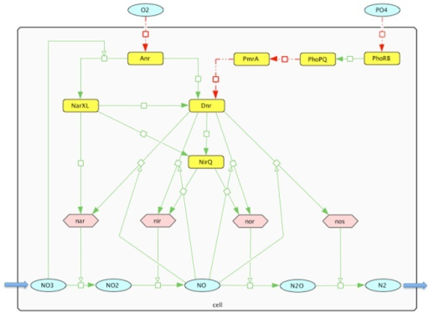
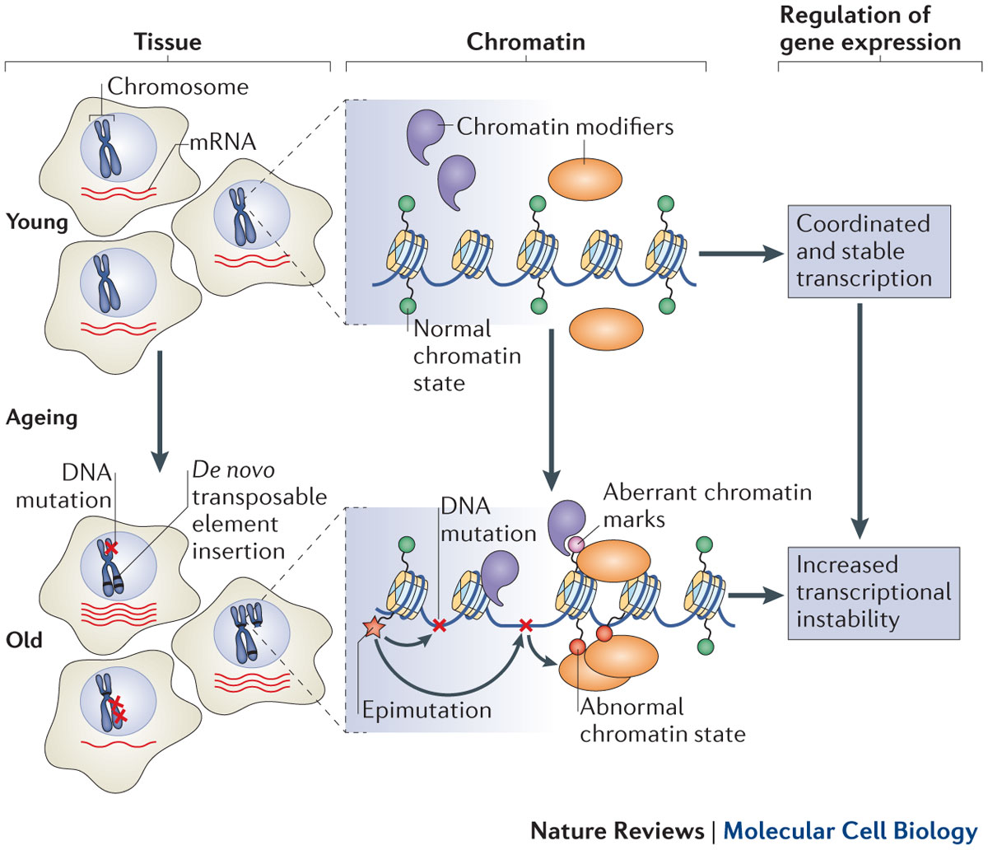
Outline Day 4
Thursday
8:30am Your Data in Context: Work with Comparative Functional Genomics Information
Judith Blake, Ph.D., The Jackson Laboratory 9:30am Network Modeling
Paola Vera-Licona, Ph.D., UConn Health
10:30am Network Modeling short exercises
Reinhard Laubenbacher, Ph.D., The Jackson Laboratory for Genomic Medicine / UConn Health
12:00pm Lunch
1:00pm Data Standards and Best Practices Data Problems: When bad things happen in genomic analysis
Judith Blake, Ph.D., The Jackson Laboratory
2:00pm Epigenomics. ChIP-seq module.
Ada Zhan, Ph.D., The Jackson Laboratory for Genomic Medicine
Shell scripts and online methods.
4:00pm Break
4:30pm Module debrief / Discussion of Participants’ Data
6:00pm Group Dinner at Butchers and Bakers

Slide 32

Outline Day 5
Friday
8:30am Integrated Modeling of Genetic and Genomic Data
Gregory Carter, Ph.D., The Jackson Laboratory
9:30am Running UG Course in Genomics -
Michael Linderman, Ph.D., Middlebury College
Andrea Tilden, Ph.D., Colby College
Shallee Page, Ph.D., Franklin Pierce Univ.
11:00am Cloud environments and web service grants
Sandeep Namburi and Aditya Srikanth Kovuri, The Jackson Laboratory - Information Technology
12:00pm Lunch
1:00pm Collaborative Discussion, Next Steps, and How to Support UG Implementations
Charlie Wray, Jeff Chuang, Reinhard Laubenbacher
pcmag.com
Notes:
Pcmag.com

Slide 33
Goals
Teaching genomics material to participants
In-class discussions of what approaches would be optimal for different institutes
Discussion of computational biology core competencies for recommendation to NIH

Slide 34
Intro to Biological Data Science

Slide 35
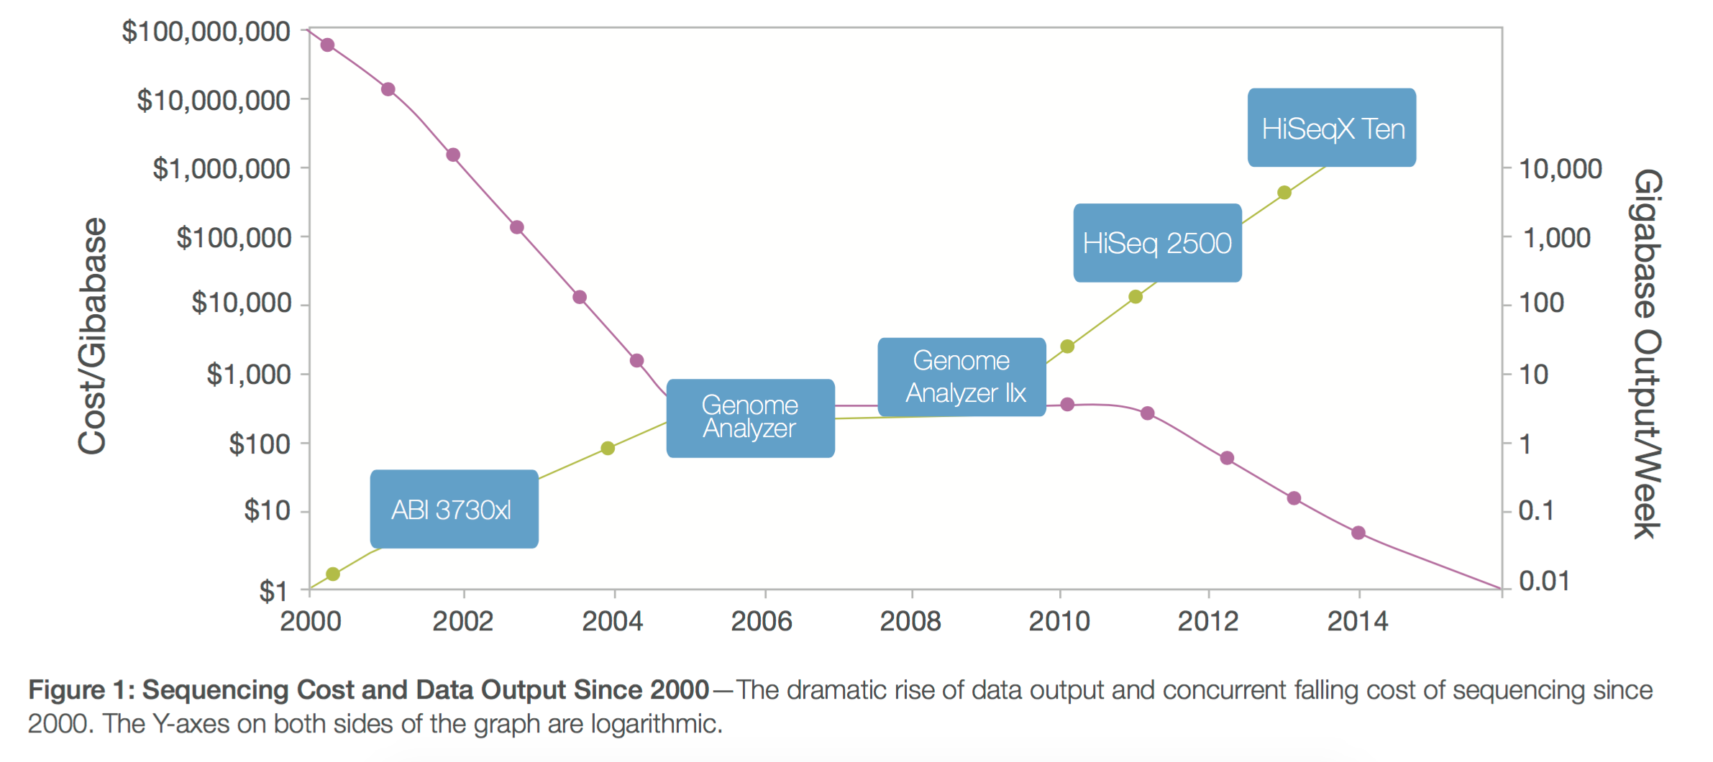
Sequencing costs over time
Sequencing costs have fallen dramatically. It now costs ~$1000 to sequence a human genome. Source: Illumina

Slide 36
The scale of biological data
Stephens ZD, Lee SY, Faghri F, Campbell RH, Zhai C, et al. (2015) Big Data: Astronomical or Genomical?. PLoS Biol 13(7): e1002195. doi:10.1371/journal.pbio.1002195
http://journals.plos.org/plosbiology/article?id=info:doi/10.1371/journal.pbio.1002195

Slide 37
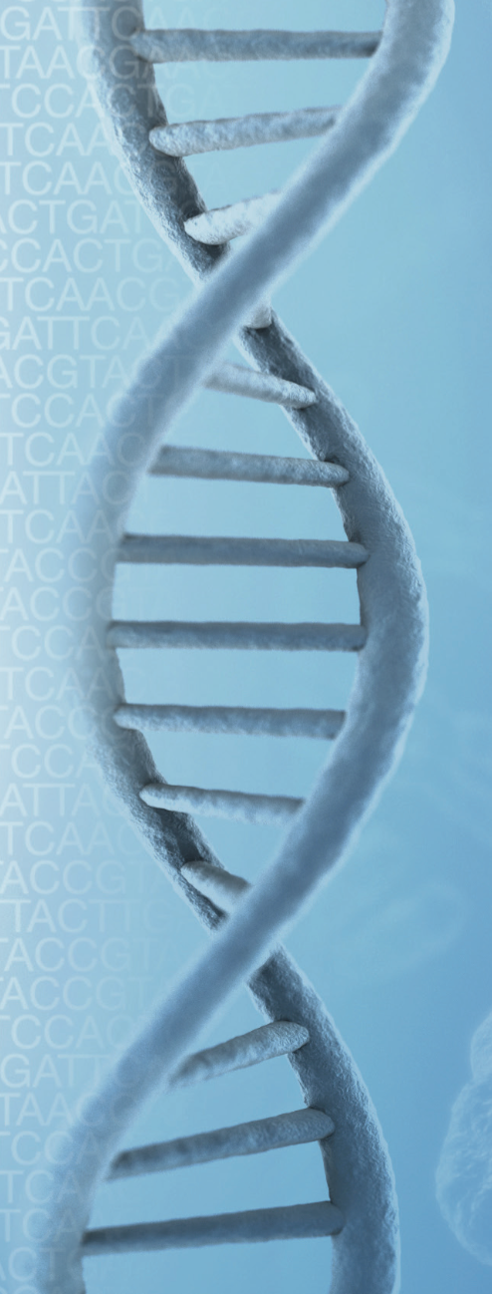
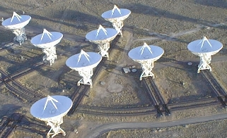
Genomics is among the biggest of big data
10²¹
Stephens ZD, Lee SY, Faghri F, Campbell RH, Zhai C, et al. (2015).
http://journals.plos.org/plosbiology/article?id=info:doi/10.1371/journal.pbio.1002195
www.vla.nrao.edu
Illumina

Slide 38
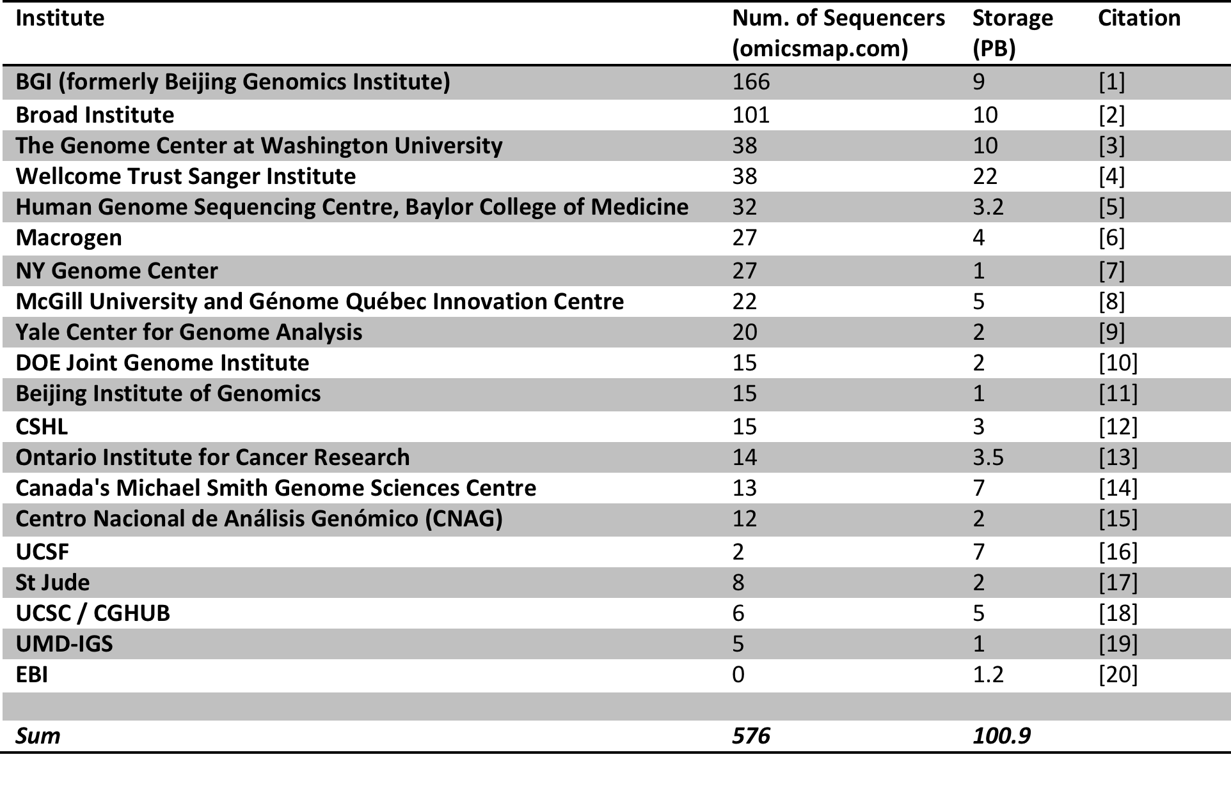
Storage at genomics centers
Stephens ZD, Lee SY, Faghri F, Campbell RH, Zhai C, et al. (2015) Big Data: Astronomical or Genomical?. PLoS Biol 13(7): e1002195. doi:10.1371/journal.pbio.1002195
http://journals.plos.org/plosbiology/article?id=info:doi/10.1371/journal.pbio.1002195

Slide 39
Big biology data require data science training
Data wrangling (raw manipulations such as obtaining, parsing, editing, merging, and filtering data)
Computational problem solving (making a pipeline run, processing and storage issues, compatibility)
Statistical tests (clustering, pathway identification, regression)
Software engineering (optimization, software robustness, visualization)
Development of new algorithms.
All of these lead up to biological interpretation and generation of new hypotheses.

Slide 40
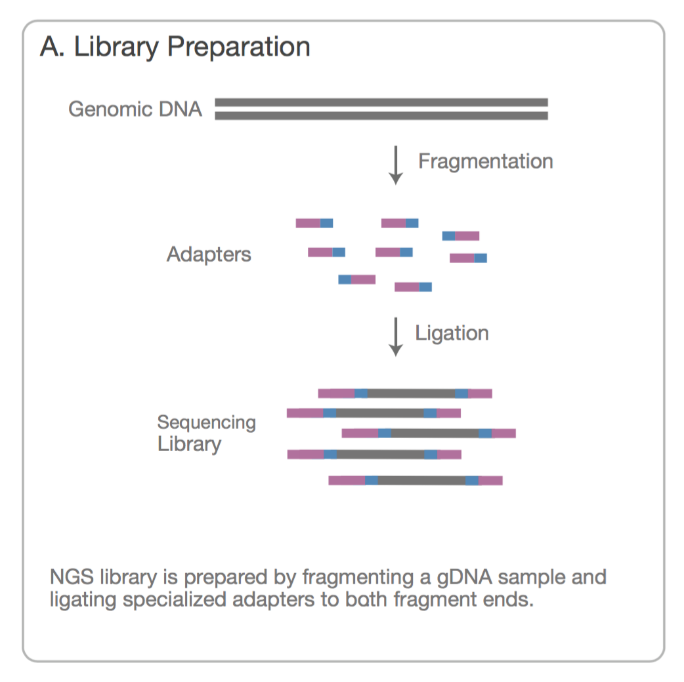
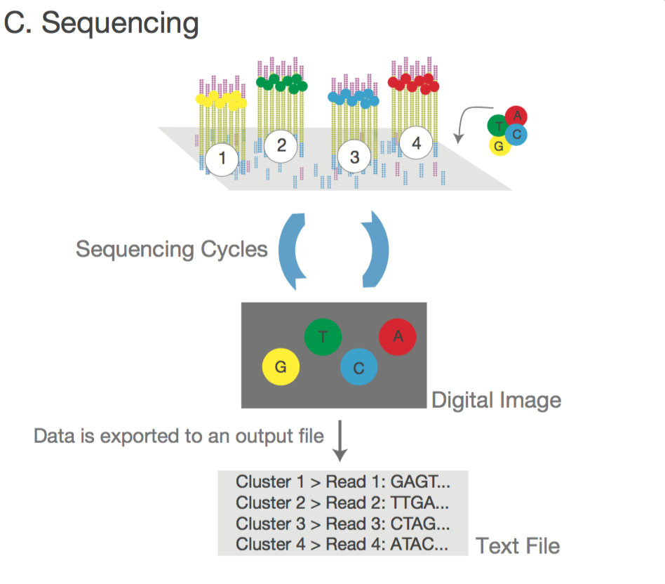
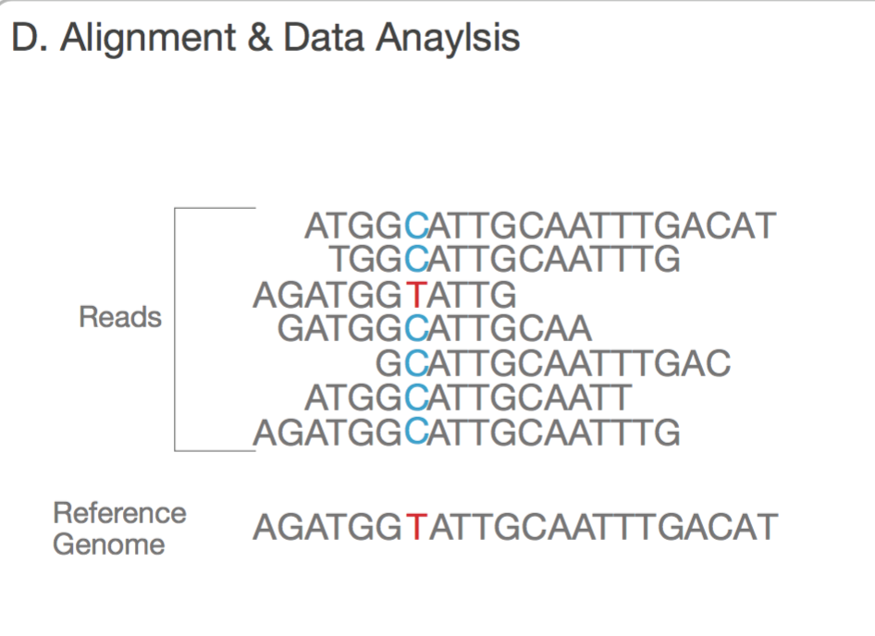
Sequencing Technology Overview
Illumina is currently the dominant sequencing technology company, though other technologies are now being developed. Adapted from Illumina materials.

Slide 41
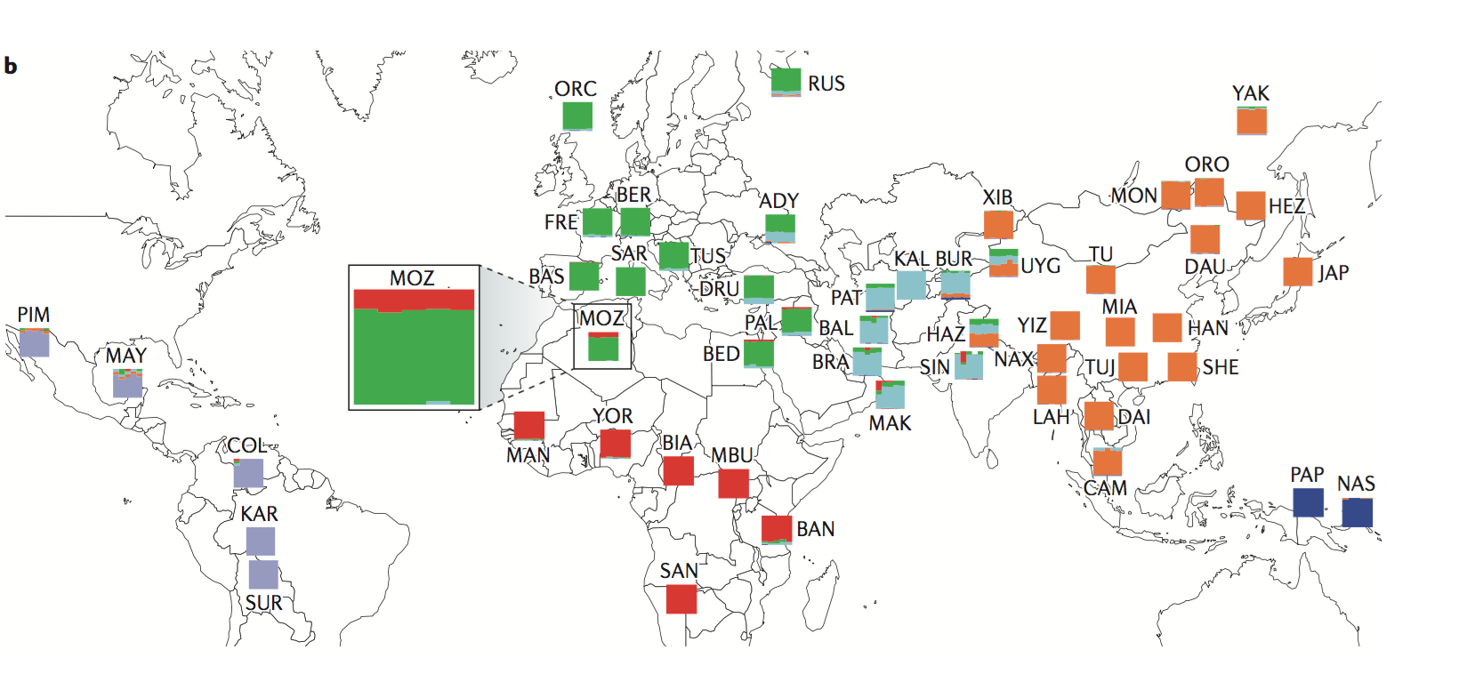
Human sequencing is the major driver of the genomics data explosion
Identification of population groups by their sequence similarity.
Nature Reviews Genetics. 2011. 12:603

Slide 42
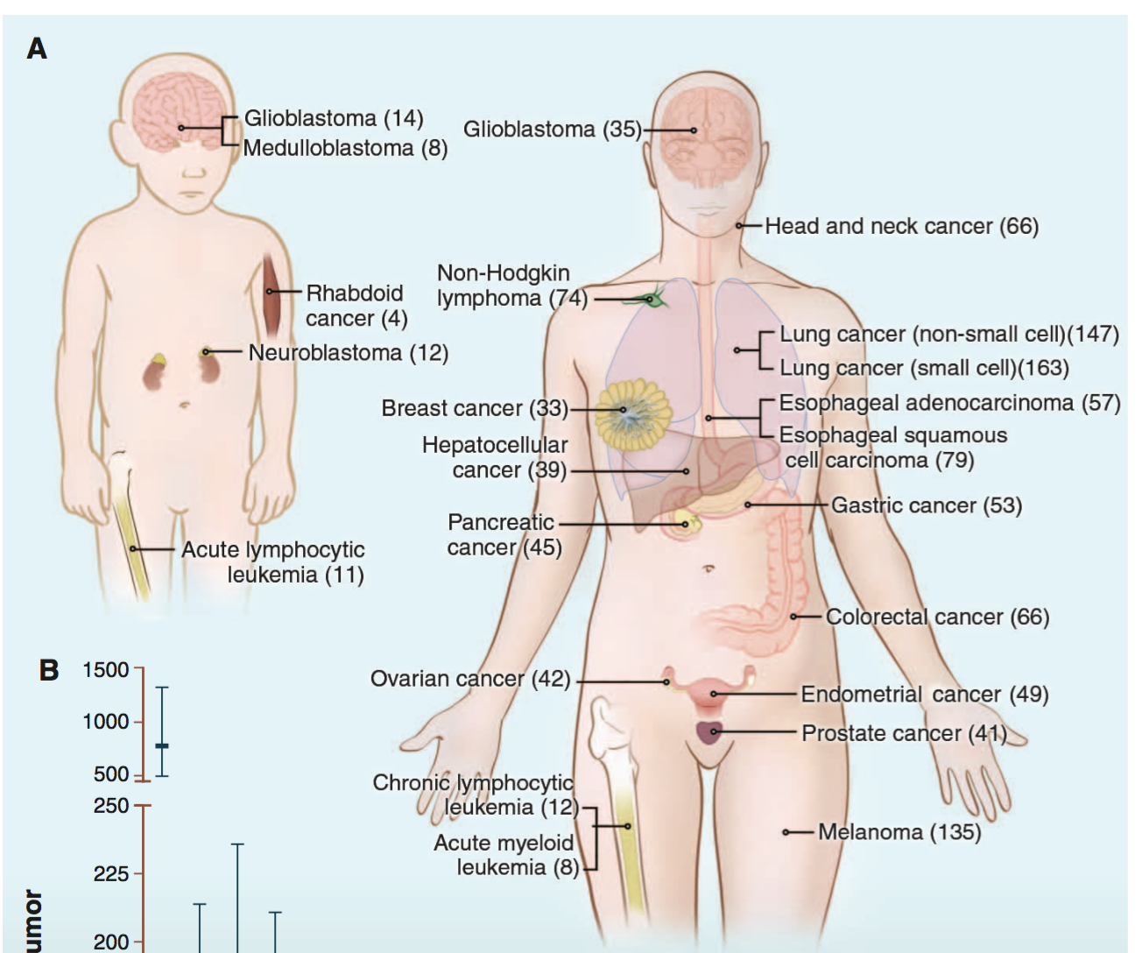
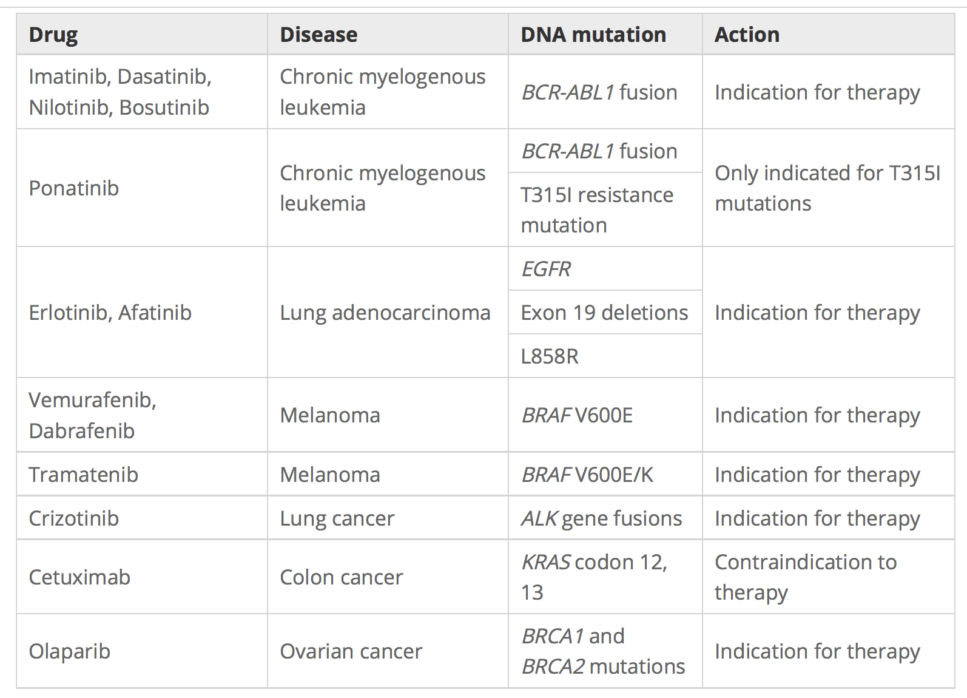
Sequencing in medicine: cancer
Average number of nonsynonymous mutations in different cancers. Science 29 Mar 2013: Vol. 339, Issue 6127, pp. 1546-1558 .
Jeffrey Gagan and Eliezer M. Van Allen. Genome Medicine 2015 7:80

Slide 43
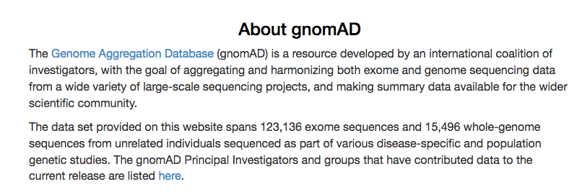
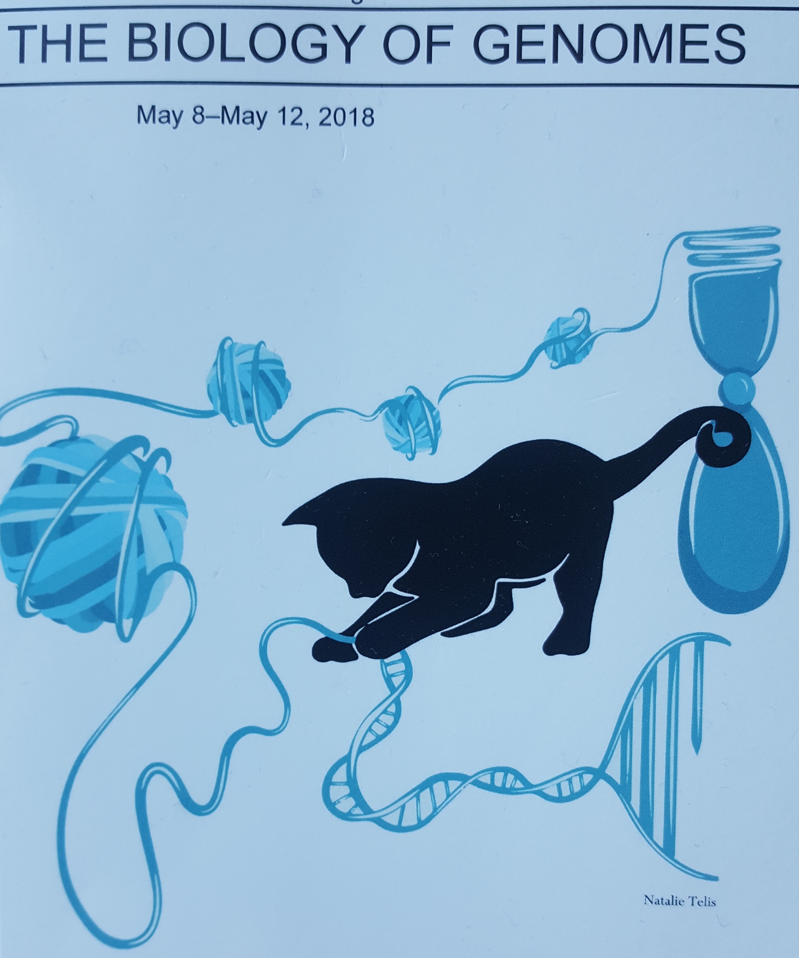
More than 100,000 human exomes are now available
http://gnomad.broadinstitute.org/about

Slide 44
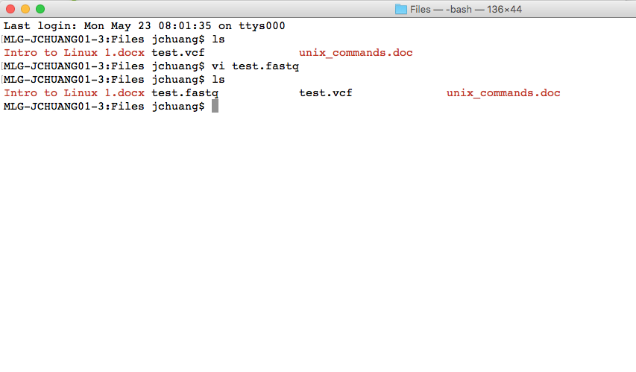
Platforms: command line

Slide 45
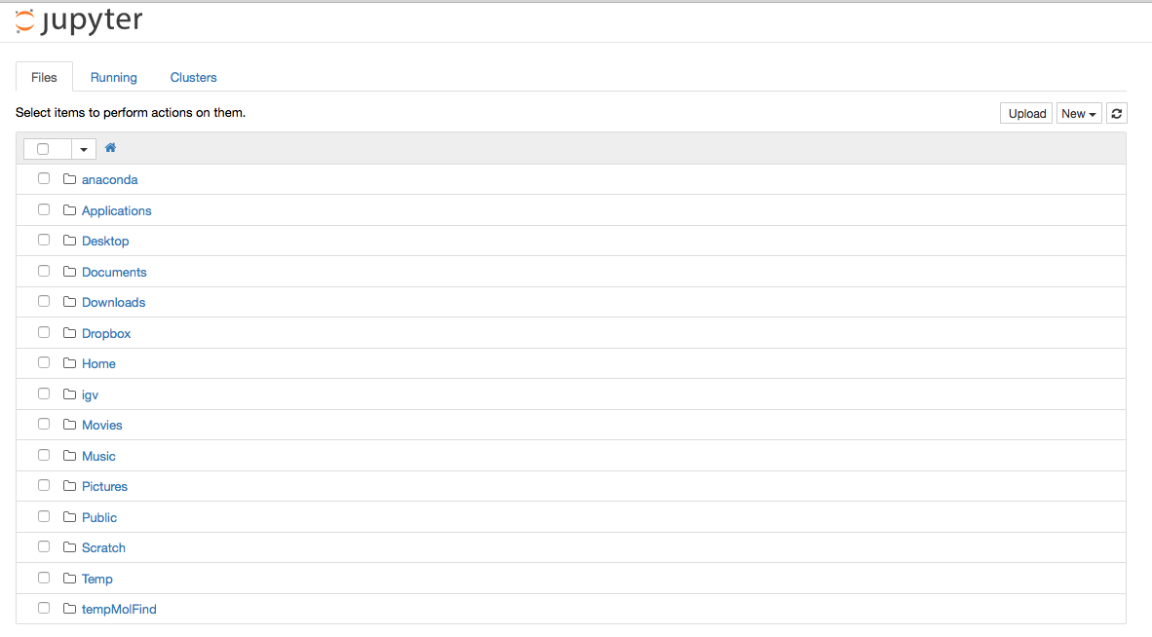
Platforms: local packages

Slide 46
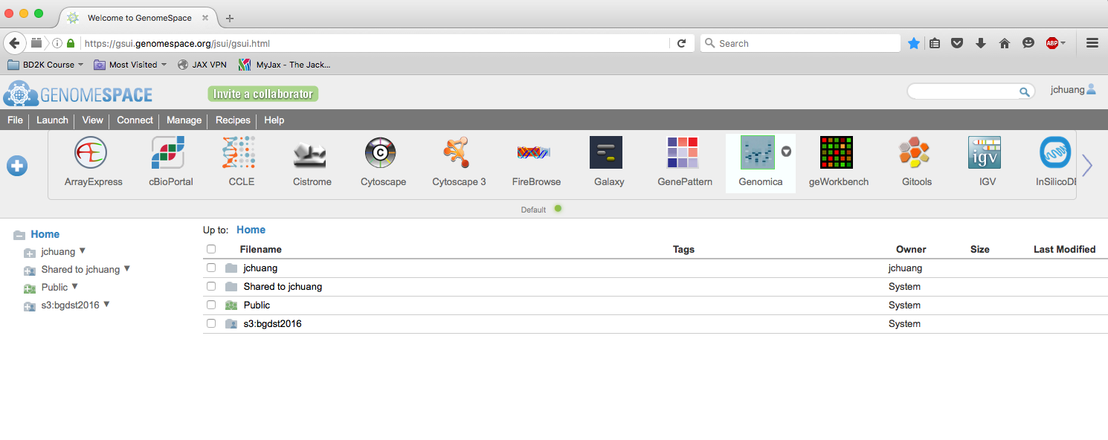
Platforms: cloud

Slide 47
Progress in computational biology topics
10 years ago introductory bioinformatics was focused on methods for small numbers of genomes and some resources.
Sequence alignment; NCBI data resources; phylogenetics; mutation calling; differential gene expression analysis; etc.
Current introductory bioinformatics is geared toward mining large datasets and applying tools to easily generated new data.
Pipelines for processing your own sequencing data ; applying existing packages for data analysis; data mining on tens to thousands of genomes; data integration.
Notes:
Pipeline tool: http://knoweng.cse.illinois.edu/training

Slide 48
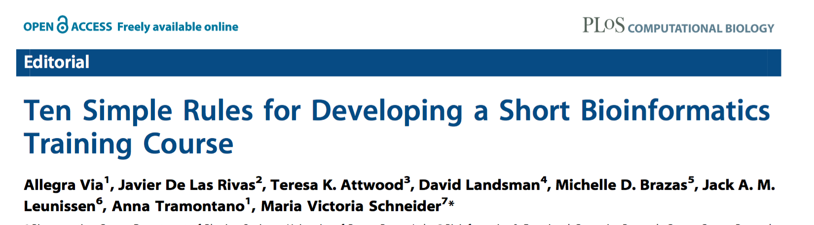
Challenges in Computational Biology Education
Breadth of field makes defining goals critical
Specialized computational resource needs
Mixing education and Interactivity
Necessary computational expertise is project dependent.
Via A, De Las Rivas J, Attwood TK, Landsman D, Brazas MD, et al. (2011) Ten Simple Rules for Developing a Short Bioinformatics Training Course. PLoS Comput Biol 7(10): e1002245. doi:10.1371/ journal.pcbi.1002245

Slide 49
Opportunities
Although computational biology resources are specialized, many are free or inexpensive.
Much data is publicly available providing abundant opportunities for new projects. Many new interfacing tools are being developed.
Rapidly advancing field provides room for a variety of approaches to pedagogy.
Well-trained students have immediate job opportunities.

Slide 50
Example Paradigm 1: Biologically Driven Approach
Goals: Teach methods that match a biology curriculum.
Example topics: expression analysis (RNA-seq data processing), mutations (Exome-seq data processing), heredity (phylogenetic methods) etc.
Challenges: Difficult to match complexity of computational approaches to biology topics. Requires easy-to-use analysis platform.

Slide 51
Example Paradigm 2: Computational Skills Approach
Goals: Development of skill in applying computational analysis techniques,
Example topics: Unix, python, R, data wrangling, web resources, common sequence analysis software, cloud implementations.
Challenges: Culture difference between programming and biology. Wide variety of choices in what skills to teach.

Slide 52
Example Paradigm 3: Data science approach
Goal: provide theoretical foundations for biology as a data science.
Example topics: clustering, regression, other data mining approaches, phylogenetics, evolution
Challenges: Difficult to identify sufficient students with both mathematical and biological interest.

